Slide 1

Coffee Shop Sales Analysis

Slide 2
Total Revenue Per Product Type
The analysis shows that Coffee is the largest revenue generator, accounting for over $336,000 in sales. This is followed by Tea and Bakery products, which are also significant contributors to the overall revenue.

Slide 3
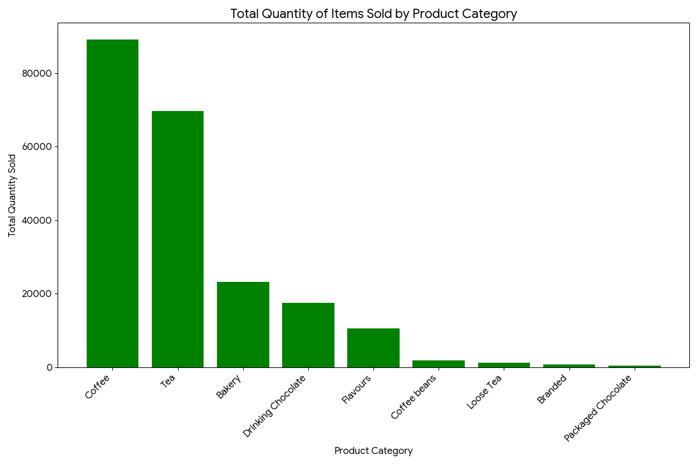
Total Revenue Per Product Type

Slide 4
Peak Time Intervals for Sales
To determine the best-performing time of day, I analyzed the sales data by the hour. The transaction_time column was used to group all sales and calculate the total revenue for each hour of the day.
The analysis reveals that the store performs best in the morning, specifically between 8 AM and 11 AM, with a peak at 9 AM when revenue reaches its highest. Another significant increase in sales is observed around 4 PM to 5 PM. This pattern suggests a strong morning rush and a smaller afternoon peak

Slide 5
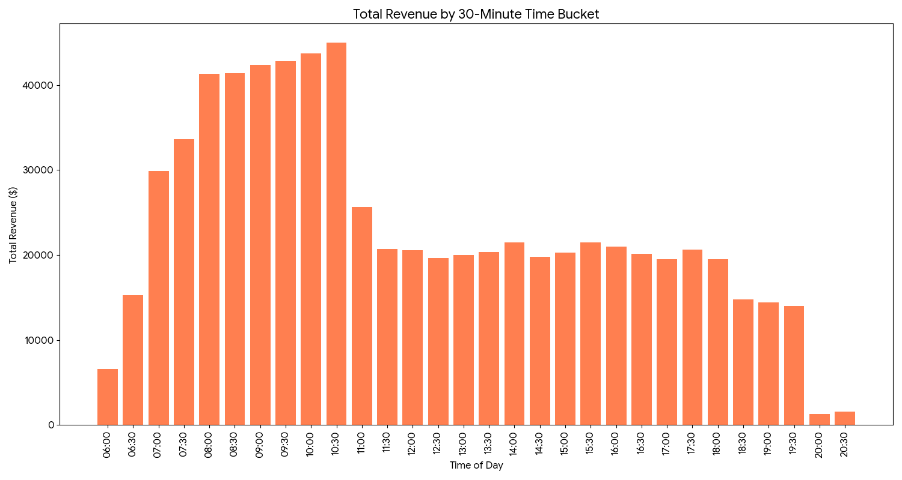
Peak Time Intervals for Sales

Slide 6
Peak Time Intervals for Sales

Slide 7
Conclusion
Recommendations 💡
Based on these insights, I propose the following recommendations to improve sales performance and operational efficiency:
Optimize the Product Mix: Given the dominance of Coffee and Tea, consider stocking more of the best-selling products within these categories, such as Earl Grey Rg and Dark chocolate Lg, to meet high demand.
Strategic Marketing: Implement marketing campaigns during slow time slots, such as the midday period (12:00 PM to 3:00 PM), to attract customers and boost sales during these lulls. Promotions, happy hour specials, or loyalty program incentives could be effective.
Promote Underperforming Products: Identify products with low sales volumes (e.g., Branded merchandise and Packaged Chocolate) and develop targeted promotions or new product placements to increase their visibility and appeal.

